Slide 1
Website: Social Trendometer
Team Aadhya
Final Presentation
Theme: Social Trends

Slide 2
Approach
Data collection using web scraping
Merge data sets and generate dictionary of social media, countries and users
Python Programming
Build website and map the values on search to map that shows bar graph
Web stack – HTML, CSS & JS
Python Programming
Social media stats
Data Preparation
Here Maps API
Website source :
https://gs.statcounter.com/social-media-stats/all/

Slide 3
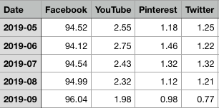
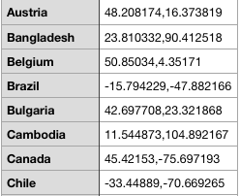
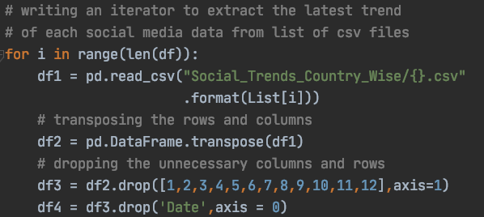
Data Preparation – Implementation (I)
Overview of data sets collected for social media data
Framing a data set for cities, latitudes and longitudes
Extracting data from datasets
Merging data to form dictionary or key value pairs
Final dictionary key value pairs sample:
{'latitude': -33.44889, 'longitude': -70.669265,
'values': [66.45, 6.58, 3.44, 12.78, 9.92, 0.57, 0.1, 0.11], 'name': 'Chile'},

Slide 4
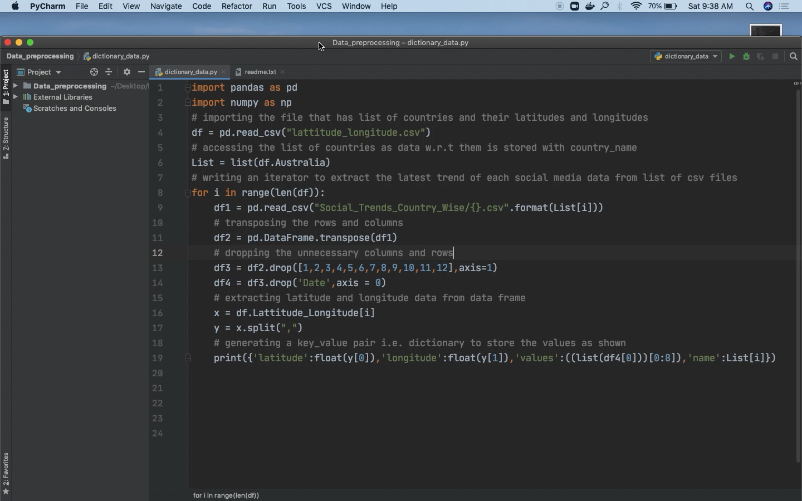
Tech Stack
Data Preparation
Python
PyCharm IDE
Pandas
NumPy
DEMO

Slide 5
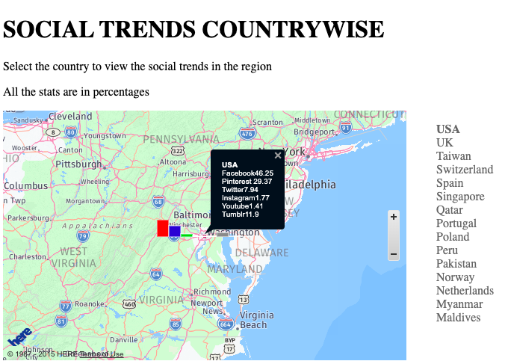
Implementation
Website Application Design
Import the prepared data into JS file
Create HERE MAPS authentication and call the API
Code using HTML and CSS for website UI
DEMO

Slide 6
Where can we use this !!
With the understanding of the patterns
in social media used by people , one can market
the new product in the right media with
maximum userbase
Further scope !!
Breaking the user base into clusters using ML algorithms
based on different features for effective target marketing

Slide 7
Website: Social Trendometer
Thank You
Team Aadhya
from
Theme: Social Trends
DEMO

